Slide 1
Lesson 3 Chapters 5-6
Packages and import
User Interface
Events
Tests (JUnit, TDD)

Slide 2



Import
Notes:
Every class is defined in a “namespace”. If you don’t specify a namespace, the class is in the “default” namespace.
The name of the class when referred from a class in another namespace, must be fully qualified.
Import is used to shorten the names, so we don’t have to specify the qualified name all the time.
You can use * (star) to import all the classes in one namespace at once, but it is better to have one line for each class that you import.

Slide 3
Swing Application
Create a JPanel
Assign a layout manager to the JPanel
Add windows controls to the Jpanel
Create a JFrame
Add the JPanel to the Jframe
Set JFrame size
Set JFrame visible

Slide 4
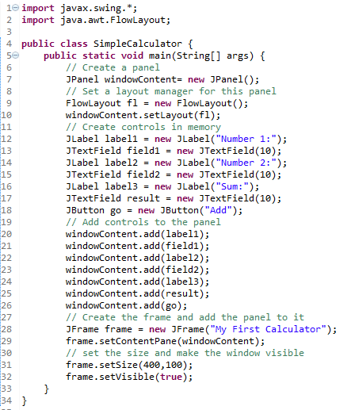
The code

Slide 5
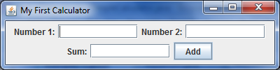
Screen shot

Slide 6
Installing Swing Designer

Slide 7
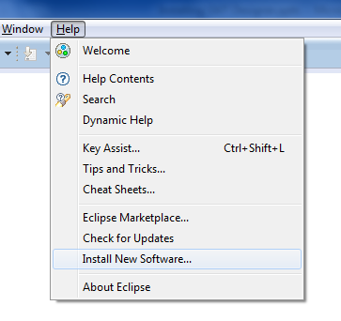
Help - Install New Software…

Slide 8
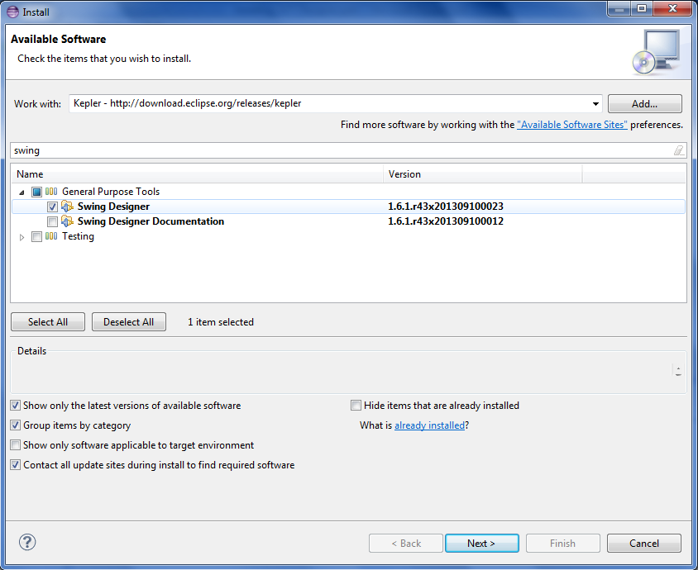
Check

Slide 9
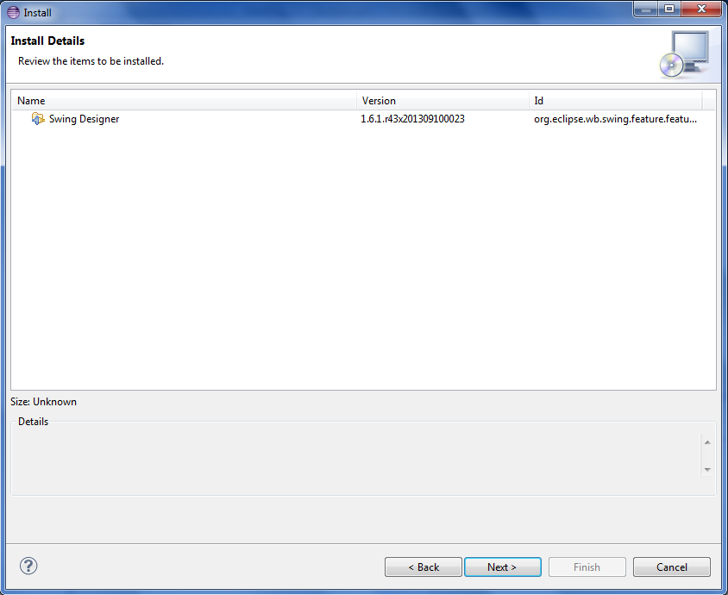
Review

Slide 10
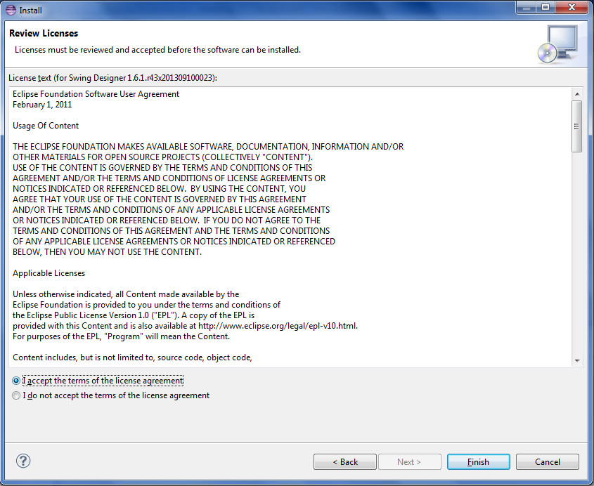
Accept license

Slide 11
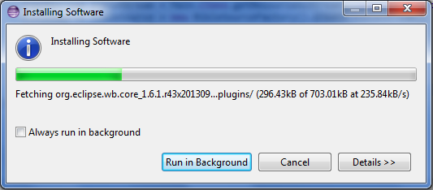
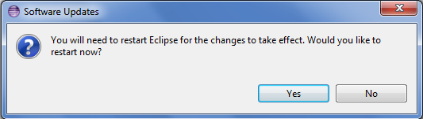
Wait

Slide 12
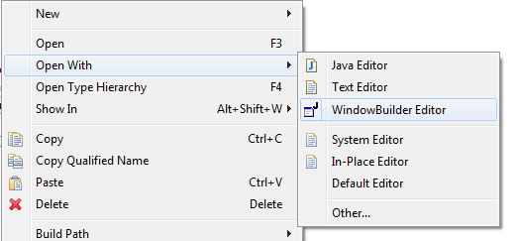
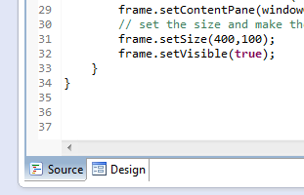
Ta-dah!

Slide 13
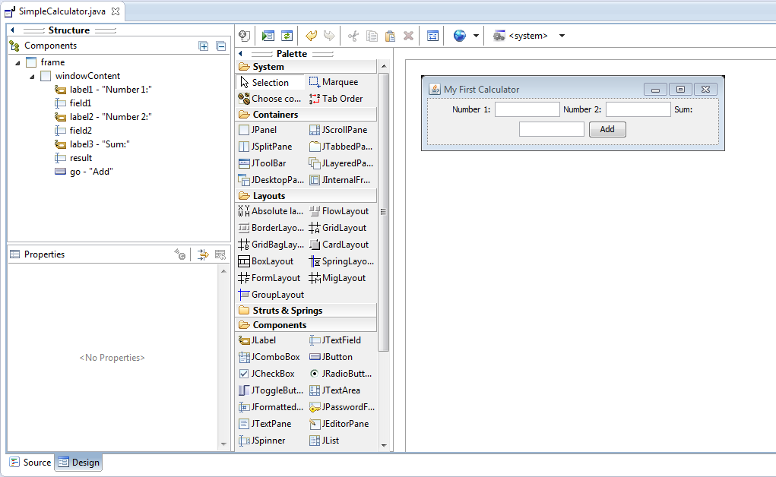
Much easier

Slide 14

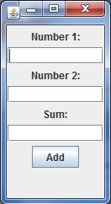
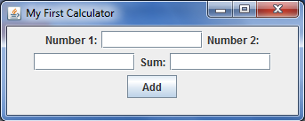
Flow Layout
Notes:
Grabbing the lower right corner, you can resize the window and see the effects of Flow Layout.

Slide 15
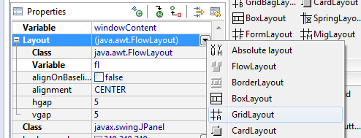
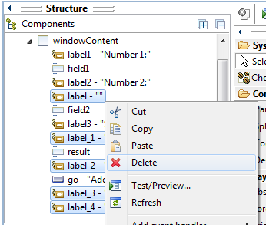
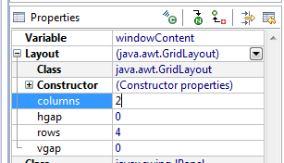
Grid Layout
Notes:
The designer added some extra labels. It’s just trying to help. Let’s get rid of those.

Slide 16


Grid Layout
Notes:
The designer added the import statement for GridLayout.
The ‘setLayout’ method call on ‘windowContent’ was changed to GridLayout.

Slide 17
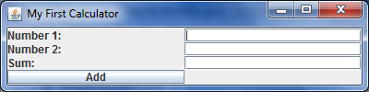
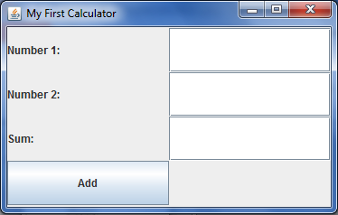
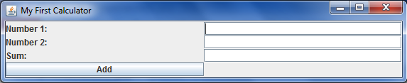
Grid Layout
Notes:
Resizing now nicely resizes the components.

Slide 18
Border Layout

Slide 19
Combine Layouts

Slide 20
Box Layout

Slide 21
Grid bag Layout

Slide 22
Card Layout

Slide 23
Window Events

Slide 24
JUnit
Tests are a way of running different parts of our code automatically to verify that they work.
Create a new source folder called ‘test’.
Add a new TestCase
Let’s make the calculator testable first
Let’s test!

